Slide 1
Data Structures and Algorithms

Slide 2

Support WEEF
Remember that WEEF is one of the few organizations which will support you throughout your undergraduate career
http://www.weef.uwaterloo.ca/

Slide 3
ECE 150 Fundamentals of Programming
ECE 150 covered:
The history of computing / objects / types / console I/O
Operators / loops / methods / parameter passing
Selection statements / arrays / strings
Exceptions / debugging
File input / file output
Pointers / unsafe code / linked lists
Collections / multi-dimensional arrays / search algorithms
Sorting algorithms
Object-oriented design / polymorphism / interfaces / inheritance
Abstract class

Slide 4
ECE 150 Fundamentals of Programming
These were the basics of programming
The ability to manipulate the computer to perform the required tasks
You saw data storage techniques:
Arrays, and
Linked lists (collections were discussed)
You saw array accessing/manipulation techniques:
Searching, and
Sorting

Slide 5
ECE 250 Algorithms and Data Structures
In this course, we will look at:
Algorithms for solving problems efficiently
Data structures for efficiently storing, accessing, and modifying data
We will see that all data structures have trade-offs
There is no ultimate data structure...
The choice depends on our requirements

Slide 6
ECE 250 Algorithms and Data Structures
Consider accessing the k^{th} entry in an array or linked list
In an array, we can access it using an index array[k]
You will see in ECE 222 that there is a single machine instruction for this
We must step through the first k – 1 nodes in a linked list
Consider searching for an entry in a sorted array or linked list
In a sorted array, we use a fast binary search
Very fast
We must step through all entries less than the entry we’re looking for
Slow

Slide 7
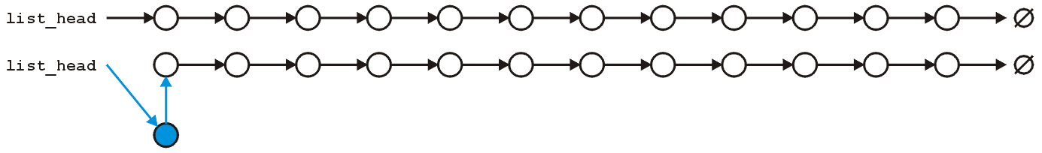
ECE 250 Algorithms and Data Structures
However, consider inserting a new entry to the start of an array or a linked list
An array requires that you copy all the elements in the array over
Slow for large arrays
A linked list allows you to make the insertion very quickly
Very fast regardless of size

Slide 8
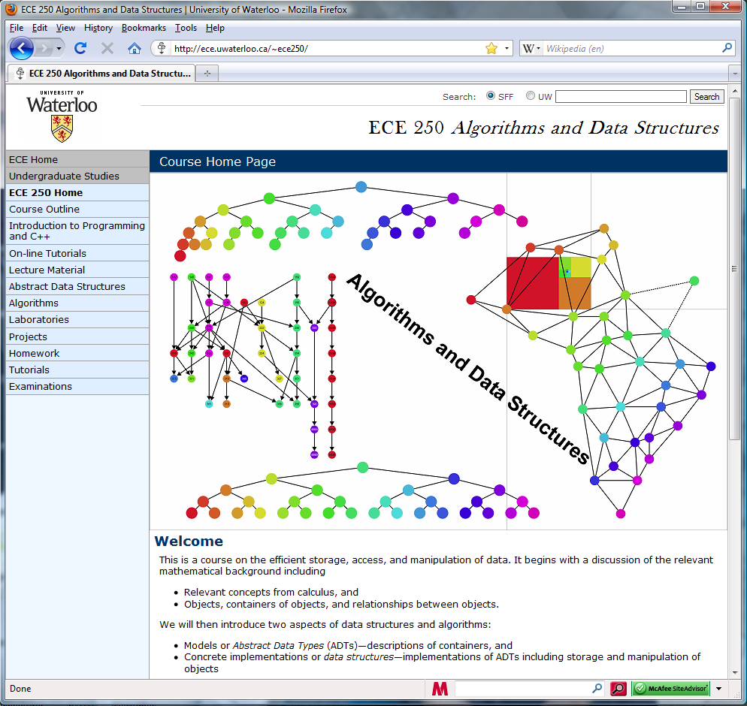
ECE 250 Algorithms and Data Structures
All course-related material on the course web site
http://ece.uwaterloo.ca/~dwharder/aads/
This includes:
The Course Outline
Various tutorials
Lecture Material
Lecture Topics
Projects
Homework
Tutorial summaries
Examination Details

Slide 9
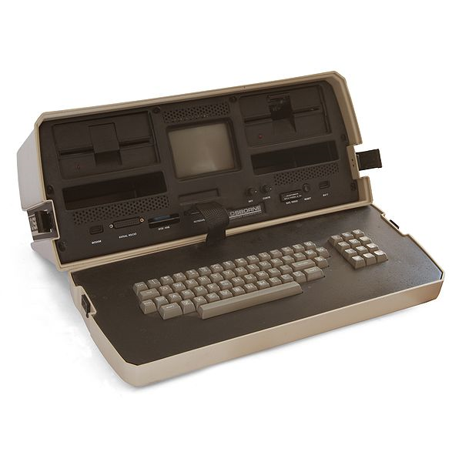

Classroom Etiquette
All laptop computers, cell phones, tablet computers must be closed during all classroom hours
If you wish to use a computer, you are welcome to step outside
Computers distract the most people behind and around the user
You require a Verification of Illness form to use a computer in class
The classroom is not for watching the next football match—even if your country is playing—but you are welcome to sit outside
Bilby
© FIFA

Slide 10
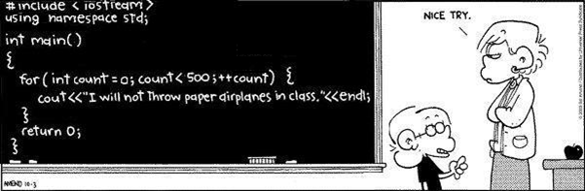
C++
You will be using the C++ programming language in this course
Modified for C++ from http://www.foxtrot.com/

Slide 11
C++
This course does not teach C++ programming
You will use C++ to demonstrate your knowledge in this course
One lecture covers:
Features of C++ and differences with C#
An on-line tutorial is available on the course web site
It assumes minimal knowledge of programming
Please note: marks in ECE 250 are not strongly correlated with marks in ECE 150

Slide 12
C++
Other sources of help in C++ are:
The Project T.A.s,
The lab instructor, and
The instructor
Other online tutorials: http://www.cplusplus.com/
Laboratories are held every second week
All laboratory material the course web site
Laboratories is associated with a project
Project 0 has no marks but allows you to practice C++

Slide 13
Unix
You will also be exposed to the Unix environment
All the projects will be marked in Unix using the g++ compiler
Its usage is similar to that of the cs command-line compiler for C# used in ECE 150
A Unix tutorial is also available
You can develop your code on Windows, but you are responsible for testing your code to Unix

Slide 14
Evaluation
The course is divided into numerous topics
Storing ordered and sorted objects
Storing an arbitrary collection of data
Sorting objects
Graphs
Algorithm Design Techniques
There are two self-study topics:
Splay trees, and
Disjoint sets
The self study topics will appear on the final examination as bonus questions
A question for each will appear but you may only answer one

Slide 15
Evaluation
Your evaluation in this course is based on three components:
Five equally weighted projects
One mid-term examination
One final examination
A commenting bonus (up to 3%)
You must pass both the examination component and the project component separately in order to pass the course
If you fail either component, your grade is the lesser of the two
Handing in no projects will result in a grade of zero

Slide 16
Evaluation
Your grade G is calculated according to the formula:
where F, M, and P are your marks on your final, mid-term, and projects, respectively

Slide 17
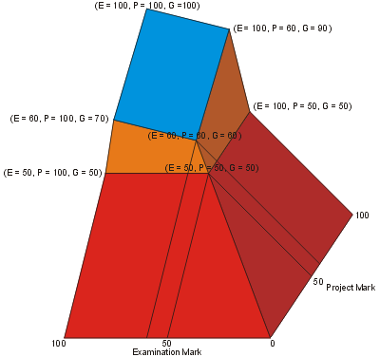
Evaluation
Here is a visual representation:

Slide 18
Evaluation
Observations:
This function is continuous (no threshold marking)
You must achieve 60% in both the projects and the examinations in order to have the usual marking scheme of 25% projects, 25% mid-term examination, and 50% final examination
You can achieve 100% on both the mid-term and the final examinations and 50% on the projects, and you will have a grade of 50

Slide 19
Evaluation
A student who misses either examination must provide:
A Verification of Illness form indicating a severe illness, or
Other formal documentation, as appropriate
With proper documentation:
Missing the mid-term examination sets E = F in the formula
Missing the final examination results in the opportunity to write with the next offering of the course
Without proper documentation:
Missing the mid-term examination results in 0
Missing the final examination results in DNW and “Required to Withdraw from Engineering”
There will be no re-weighting of the mid-term examination under any circumstances

Slide 20
Evaluation
Commenting code is necessary for engineers:
Engineers who do not comment code will not encourage employees and contracted programmers to comment their code
This will lead to significant additional costs
The commenting bonus occurs at the end of the term
Instructions for commenting code are available on the Projects web site
Quality comments are required in at least three projects for any marks to be awarded

Slide 21
Projects
For each of the five projects, you will be required to implement one or more of the data structures taught in class
We provide an environment in which we test your projects
The times the projects are due is fixed:
Projects 1, 2, 3, 4 are due Tuesday at 22:00 (10:00 P.M.) on UW Learn
Project 5 is due at 24:00 (midnight) on the last day of class
The drop-box will be kept open until 06:00 (6:00 A.M.) the following day for late submissions
Maximum grade for late submissions is 80

Slide 22
Projects
We provide a interpreter which you can use to test your software
We will use the same interpreter to test your software
Your output must perfectly match our output
Comparisons are done using text comparisons
Any debugging printouts will cause your project to fail a test

Slide 23
Projects
What happens if you make a mistake?
I will be holding one-on-one sessions with any student who got a grade on a project below 80
The maximum grade of your resubmission depends on:
 | Maximum Grade
You can articulate all errors and give fixes | 80
You require assistance in correcting one member function | 70
You require significant assistance on two member functions | 60
You made an effort with the original submission | 50

Slide 24
Projects
You are allowed to:
Make multiple submissions—we take the last
Declare and define other classes and other member functions not specified in the project descriptions
You may even, though be very cautious, overload the given member function signatures or give the functions extra parameters so long as the functions as specified may be called with no ambiguity
Use the following standard library functions (and no others):
#include <iostream> all functions and classes #include <cassert> assert( predicate ) #include <algorithm> std::max( x, y ) std::min( x, y ) The use of any other standard library function or class will result in an automatic grade of 0

Slide 25
Projects
You are responsible for the naming convention on the submitted file uwuserid_pM.tar.gz
where:
uwuserid is your uWaterloo User ID,
M is the number of the project
The execution must always be of the form
tar -cvf uwuserid_pM.tar file1.h file2.h etc.h
gzip uwuserid_pM.tar
Three students failed at life when they submitted
their project with uWaterloo User ID “uwuserid”

Slide 26
Projects
In Unix, file names are case sensitive:
The files j99smithP1.tar.gz and j99smith_p1.tar.gz are different
Also, you must use the tar and gzip utilities on Unix
Using zip (even if you rename it) doesn’t work
If you cannot submit through uWaterloo LEARN, you must e-mail the file to the Lab Instructor
Any penalty is based on the time stamp at which the e-mail is received (not sent)
You are responsible for all information on the site
ece.uwaterloo.ca/~dwharder/aads/Projects/

Slide 27
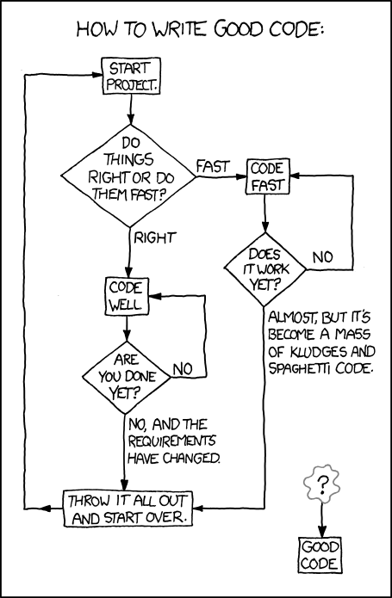
Projects
Even xkcd has some advice on coding...
http://xkcd.com/844/

Slide 28
Improving Your Performance
The human brain can retain approximately 5-9 independent items of information in its short-term memory
George Miller, The Magical Number Seven, Plus or Minus Two: Some Limits on Our Capacity for Processing Information, Psychological Review, Vol.63 pp.81–97, 1956
The introduction of new information causes the brain to discard an item currently in your short-term memory
For example, consider the 12 words which will appear on the next sequence of screens
Your goal: at the end, write down all twelve words

Slide 29
Improving Your Performance
Cat

Slide 30
Improving Your Performance
Ultimate

Slide 31
Improving Your Performance
Knife

Slide 32
Improving Your Performance
Asteroid

Slide 33
Improving Your Performance
Motion

Slide 34
Improving Your Performance
Shipwreck

Slide 35
Improving Your Performance
Peach

Slide 36
Improving Your Performance
Ford

Slide 37
Improving Your Performance
Pencil

Slide 38
Improving Your Performance
Metre

Slide 39
Improving Your Performance
Curtain

Slide 40
Improving Your Performance
Forever

Slide 41
Improving Your Performance
Now, write down as many of these words as you can
Most of you will be able to write down somewhere between 7 through 9 of these
It may even be possible to remember more new topics, however, you will note that there is no relationship between these objects

Slide 42
Improving Your Performance
To transfer information from your short-term memory to your long-term memory, that information must be imposed on your mind at least three times
You should always try the following:
Look at the slides before class
Attend lectures
You see the information again with commentary
Review the lecture during the evening
Rewrite and summarize the slides in your words

Slide 43
Improving Your Performance
In addition to this, you should:
Get a reasonable nights sleep (apparently this is when information is transferred to your long-term memory), and
Eat a good breakfast (also apparently good for the memory)

Slide 44
Improving Your Performance
Like other courses, this course builds on previous information
I will not answer questions about material which I have either previously covered or indicated that you are required to read
Also, neither the T.A.s nor myself will be available for help either on the day of the mid-term or final examinations
There is no help which can be derived in that time, and therefore, to impress this upon you, you must study before-hand if you believe you will need help

Slide 45
Academic Offences
Academic Offences include, but are not limited to:
Infringing unreasonably on the work of other members
E.g., disrupting classes
Cheating
Plagiarism
Misrepresentations
All students must read Policy 71

Slide 46
Plagiarism
All projects must be done individually:
You may not copy code directly from any other source
Plagiarism detection software will be used on all of the projects
If you viewed another code (from books or lecture notes), you must include a reference in your project
You may not share code with any other students by transmitting completed functions to your peers
This restriction includes—but is not limited to—electronic and hard-copy sharing
You may discuss projects together and help another student debug his or her code; however, you cannot dictate or give the exact solution

Slide 47
Plagiarism
Projects will be submitted to MOSS for plagiarism detection
(Measure Of Software Similarity)
This plagiarism-detection software hosted on a Stanford University server and is based on the paper
Winnowing: Local Algorithms for Document Fingerprinting
by Saul Schleimer, Daniel S. Wilkerson, and Alex Aiken
You are only asked for you uWaterloo User ID in both the project files and the name of the submitted file
It is not recommended that you include either your full name or your uWaterloo Student ID Number

Slide 48
Plagiarism
Collaboration with other students must be limited to
Discussions
High-level pseudocode
Assistance with debugging (only through the offering of advice)
Sharing test files
All such collaborations must be documented in your source code

Slide 49
Plagiarism
When one student copies from another student, both students are responsible
Exceptions are made for outright theft
The penalty for plagiarism on a Project is a mark of 0 on the project in question and a further 5% is subtracted from your final grade
Regardless if Projects are counted or not

Slide 50
Plagiarism
One student cannot accept “full responsibility”
For example, Alex, Bailey, Casey, and Devin worked together in a group
They each did their own work, however, they shared code to comment on each others programming
Bailey gave Alex’s code to Emerson who copied it for his project and submitted it
Alex, Bailey and Emerson received a 0 and -5 %

Slide 51
Plagiarism: Example 1
Alex and Bailey were lab partners in ECE 222
Bailey left herself logged on Unix to allow Alex to complete the lab
Alex copied Bailey’s ECE 250 project

Slide 52
Plagiarism: Example 2
Leslie asked if Morgan could send her his code so that she could look at it (promising, of course, not to copy it)
Morgan sent the code
Leslie copied it and handed it in

Slide 53
Plagiarism: Example 3
Erin did not chance her default password
Fanny logged onto Erin’s account and took Erin’s code
Erin is still responsible

Slide 54
Plagiarism: Example 4
Garry and Harry worked together on a single source file initially and then worked separately to finish off the details
The result was still noticeably similar with finger-print-like characteristics which left no doubt that some of the code had a common source

Slide 55
Plagiarism: Example 5
Jordan uploaded the projects to GITHUB.com without setting appropriate permissions. Kasey found this site, downloaded the projects and submitted them. Both are guilty.
This applies to any public forum, news group, etc., not just gitub.com…

Slide 56
Plagiarism
The minimum penalty for plagiarism is 0 on the project and -5% on your final mark for each case of plagiarism
the penalty is applied regardless of what proportion the Projects are of your final grade
A student who cheats must receive a grade lower than a student who did not hand in a project

Slide 57
Plagiarism
All instances of plagiarism are reported to the Associate Dean of Undergraduate Studies
The Associate Dean may increase the penalty, including:
requiring four extra courses in ethics
a suspension
expulsion

Slide 58
Plagiarism
Please note that if you get 70% on:
all projects,
the mid-term examination, and
the final examination
and you are caught once for plagiarism, your course average will be 61.5

Slide 59
Plagiarism
The best way to avoid plagiarism is:
review the C++ tutorial
read the project as soon as it is available
start the project so that there is sufficient time to contact the T.A. or myself if you have difficulty
do not give your code to anyone

Slide 60
Distribution of Information
Information may be pass to the class through one of two media:
An announcement in class,
An e-mail via an e-mail through uWaterloo LEARN

Slide 61
Summary
In this topic, we have:
Outlined the course
Discussed C++ and the projects
Improving your performance
Discussed plagiarism and its consequences

Slide 62
Usage Notes
These slides are made publicly available on the web for anyone to use
If you choose to use them, or a part thereof, for a course at another institution, I ask only three things:
that you inform me that you are using the slides,
that you acknowledge my work, and
that you alert me of any mistakes which I made or changes which you make, and allow me the option of incorporating such changes (with an acknowledgment) in my set of slides
Sincerely,
Douglas Wilhelm Harder, MMath
dwharder@alumni.uwaterloo.ca

